Slide 1

Something From Nothing
Ryan Coyne

Slide 2
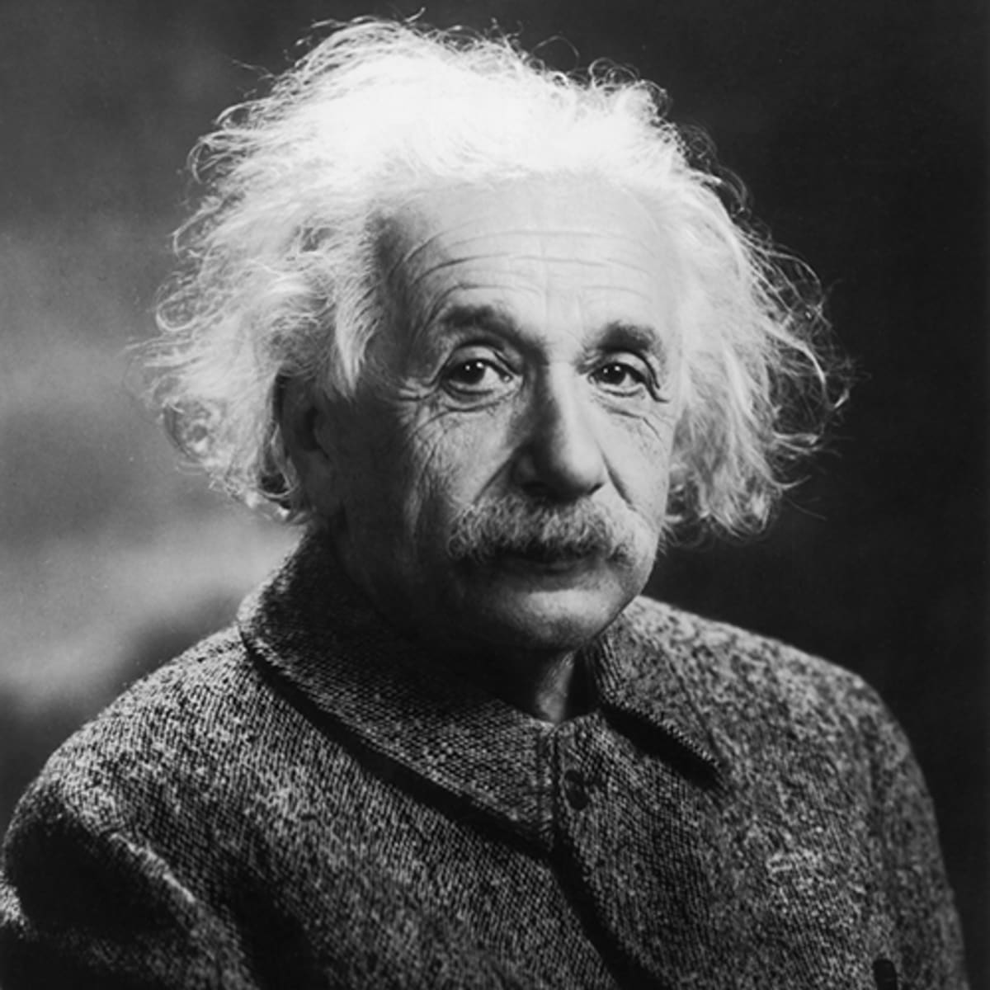


Albert Einstein
$Δm=\frac{L}{c^{2}}$
$E=mc^{2}$
Notes:
Mass is a measure of a body’s energy content.

Slide 3
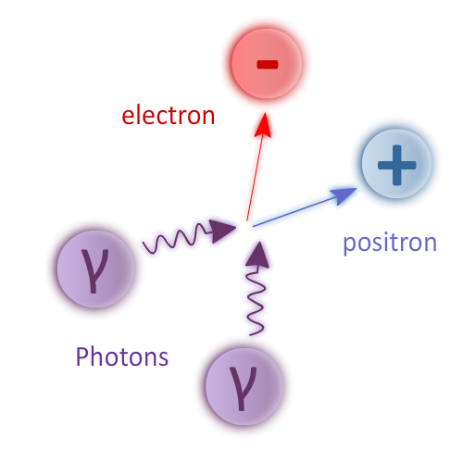
Breit-Wheeler
Gregory Breit and John A. Wheeler
Described in 1934
Two types
Non-linear observed in 1997
Notes:
Mass is a measure of a body’s energy content.

Slide 4
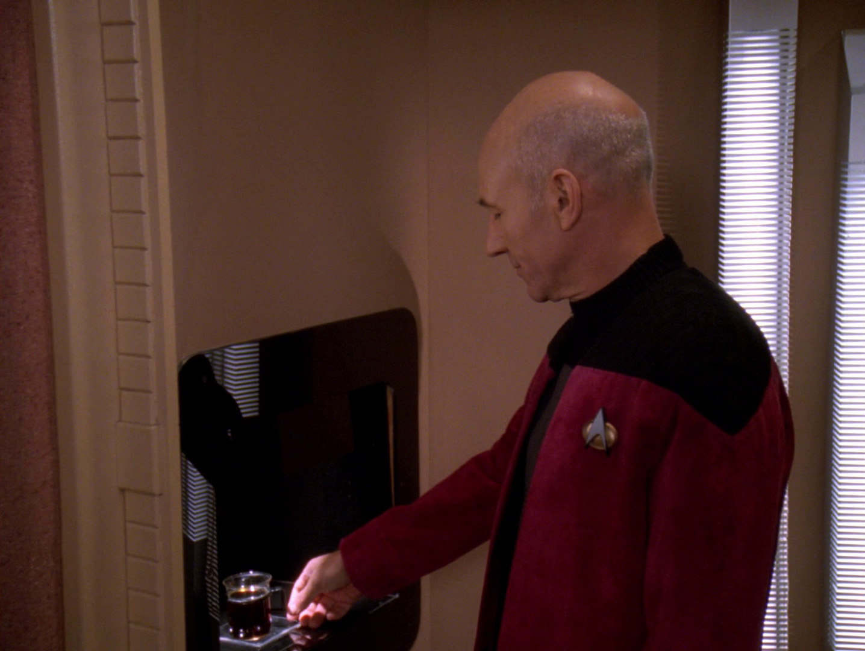
Science Fiction

Slide 5
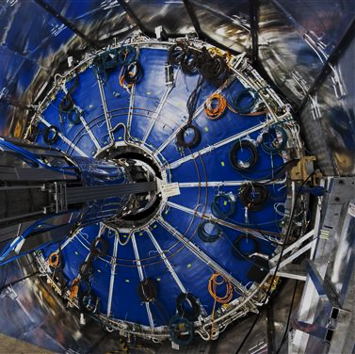
Upton, New York
RHIC
Heavy ions accelerated to relativistic speeds
Ultra-peripheral Au+Au Collisions

Slide 6
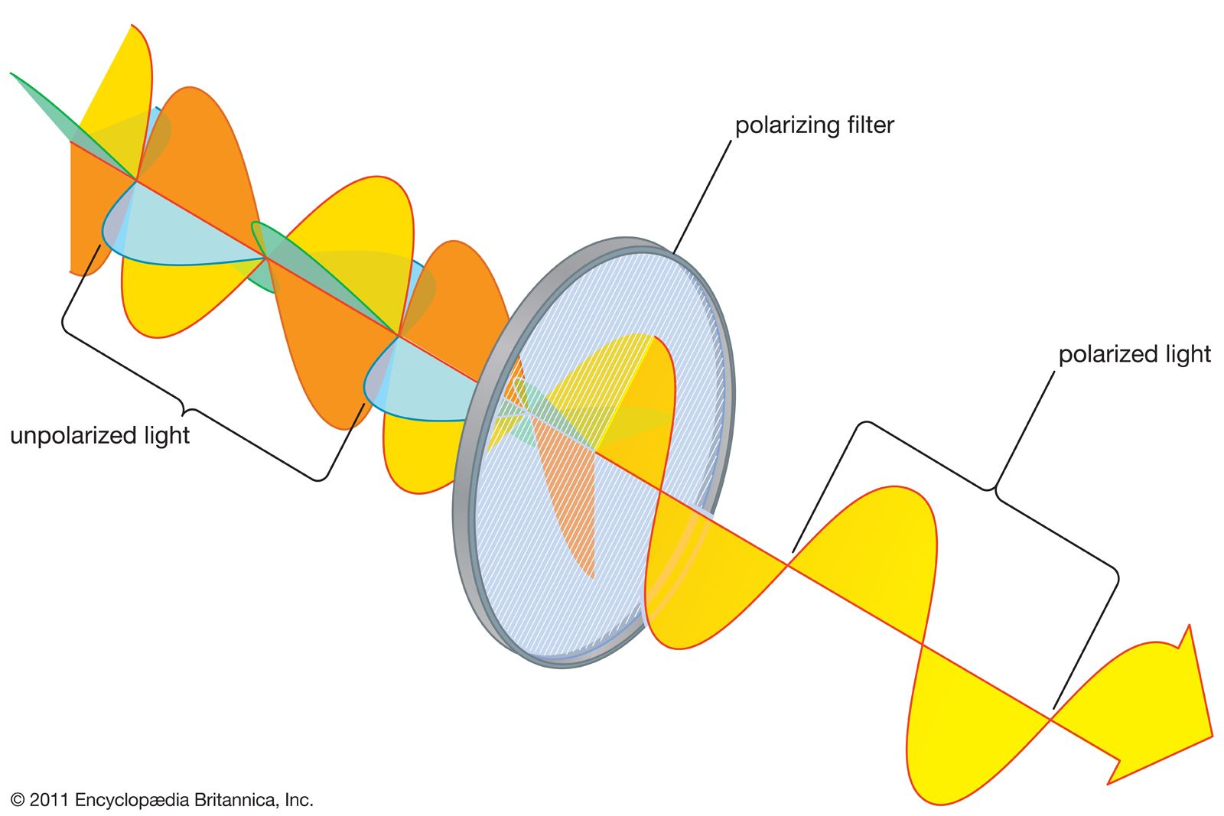
Light Bending
Polarized empty space
Deflects photons
Birefringence

